Slide 1
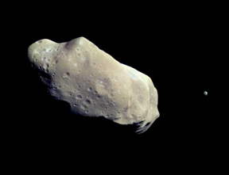
Lecture 2:
A Modern View of the Universe
Asteroid Ida and satellite Dactyl
Claire Max
April 3rd, 2014
Astro 18: Planets and Planetary Systems
UC Santa Cruz

Slide 2
Topics for this class
Some definitions
What is our place in the universe?
Geometry of the Solar System
The cosmic distance scale
The expansion of the universe and the Big Bang
Dark Matter and Dark Energy
Please remind me to take break at 12:45

Slide 3
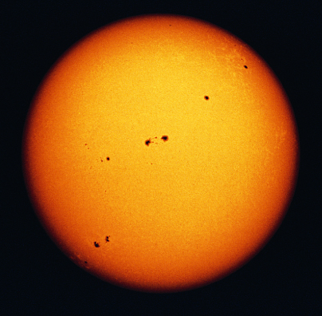
What is a Star?
A large, glowing ball of gas that generates heat and light through nuclear fusion
Nuclear Fusion:
  Energy generation mechanism in which two light atoms join together (fuse) to form a heavier atom

Slide 4
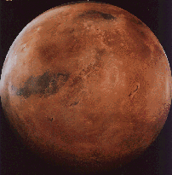
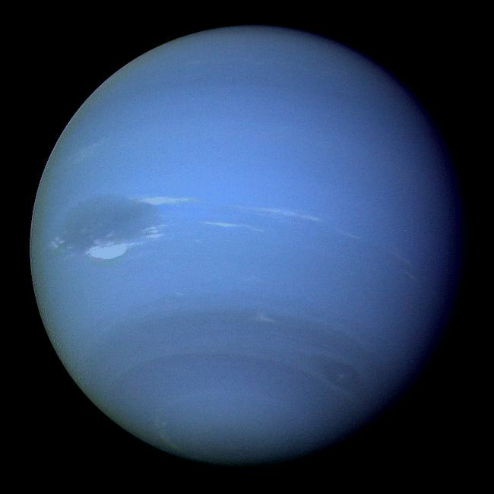
1. Planet: Intuitive Definition
Mars
Neptune
A moderately large object that orbits a star.
It shines mostly by reflected light from its parent star.

Slide 5
2. Planet: International Astronomical Union Definition
A celestial body that
  (a) is in orbit around the Sun
  (b) has sufficient mass for its self-gravity to overcome rigid body forces, so that it assumes a hydrostatic equilibrium (nearly round) shape, and
  (c) has cleared the neighbourhood around its orbit.
Note that by design, this definition only applies to planets in our Solar System. Definition of planets in other Solar Systems was postponed until future deliberations of the IAU.

Slide 6
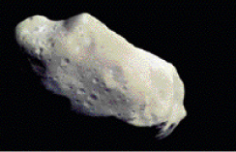
Asteroid
A relatively small and rocky object that orbits a star.
Ida
Notes:
The textbook suggests also pointing out:
(1) Note the non-spherical shape; small objects are often non-spherical because their gravity is not strong enough to compress the material into a sphere.
(2) Asteroids are sometimes called minor planets because they orbit much like planets but are smaller than anything we consider
to be a true planet.

Slide 7
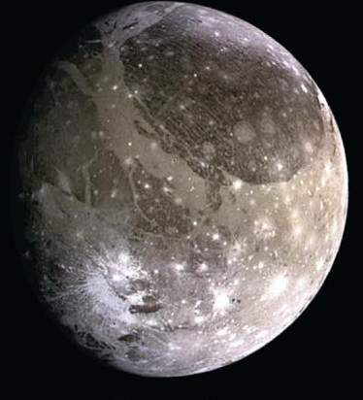
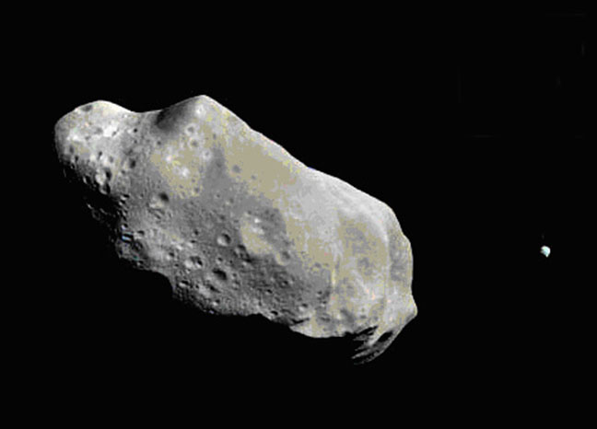
Moon (or satellite)
An object that orbits a planet
An object that orbits another Solar System object
Ganymede (orbits Jupiter)
Dactyl (orbits the
asteroid Ida)

Slide 8
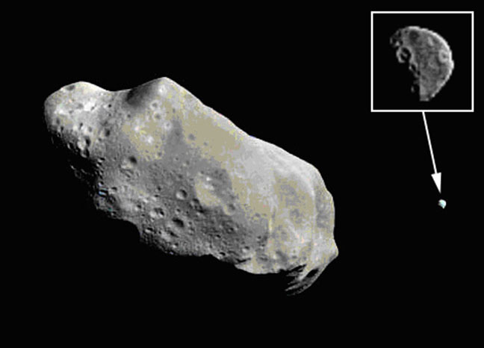
Moon (or satellite)
An object that orbits a planet
An object that orbits another Solar System object
Ganymede (orbits Jupiter)
Dactyl (orbits the
asteroid Ida)

Slide 9
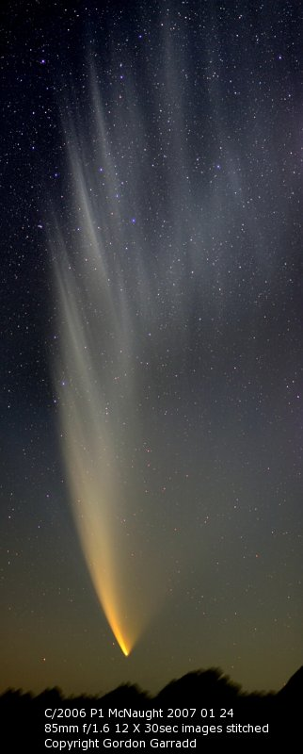
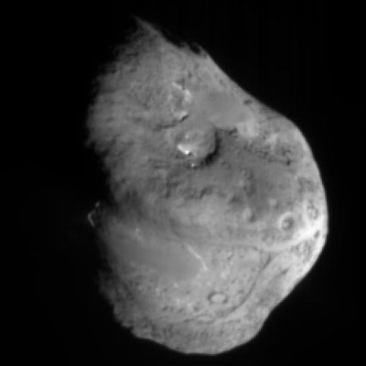
Comet
A relatively small and icy object that orbits a star.
Tail
(gas
and dust)
Comet nucleus
Notes:
The textbook suggests also pointing out:
(1) the basic difference between an asteroid and a comet is composition; (2) comets have tails ONLY when they come close to the Sun, not when they are much farther away.

Slide 10
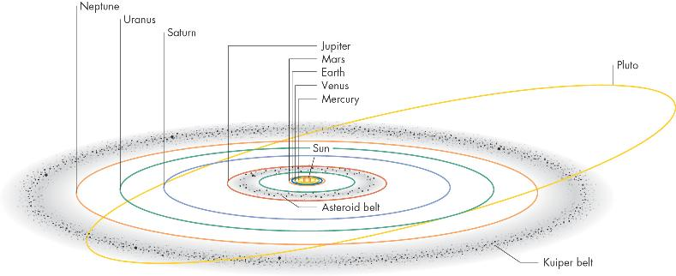
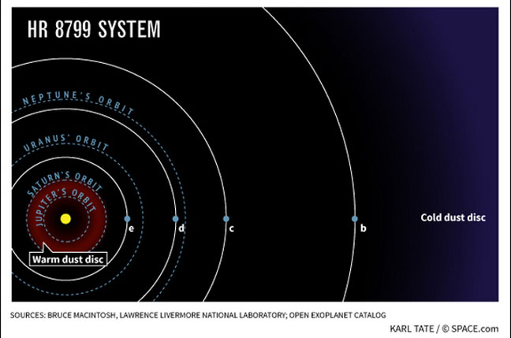
Solar (Star) System
A star and all the material that orbits it, including its planets, moons, asteroids, comets
Credit: O’Connell, U Va.

Slide 11
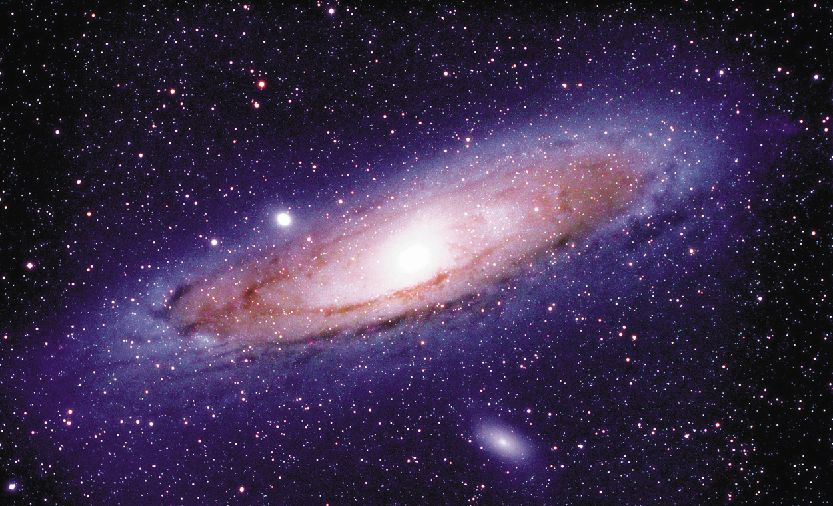
Galaxy
M31, The Great Galaxy
in Andromeda
A very large grouping of stars in space, held together by gravity and orbiting a common center.
Masses: 10⁷ - 10¹³ times the mass of our Sun
Notes:
The textbook says that one of the most common student problems is confusion between the terms “solar system” and “galaxy.”

Slide 12
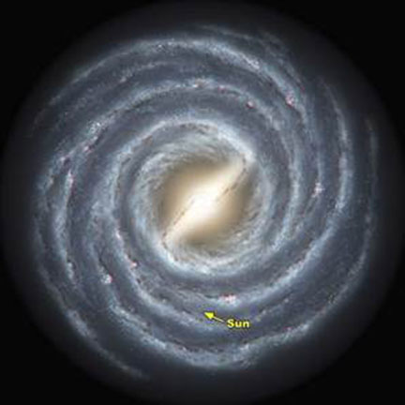
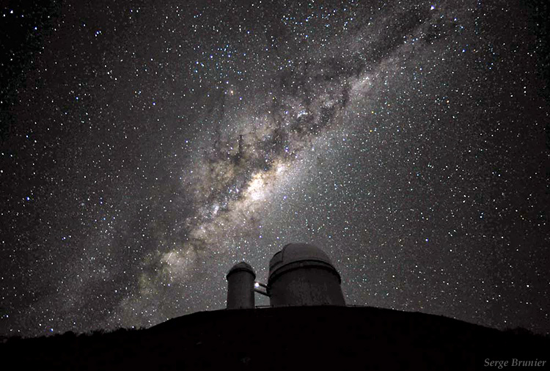
Our Milky Way Galaxy
Under the River of Stars © Serge Brunier

Slide 13
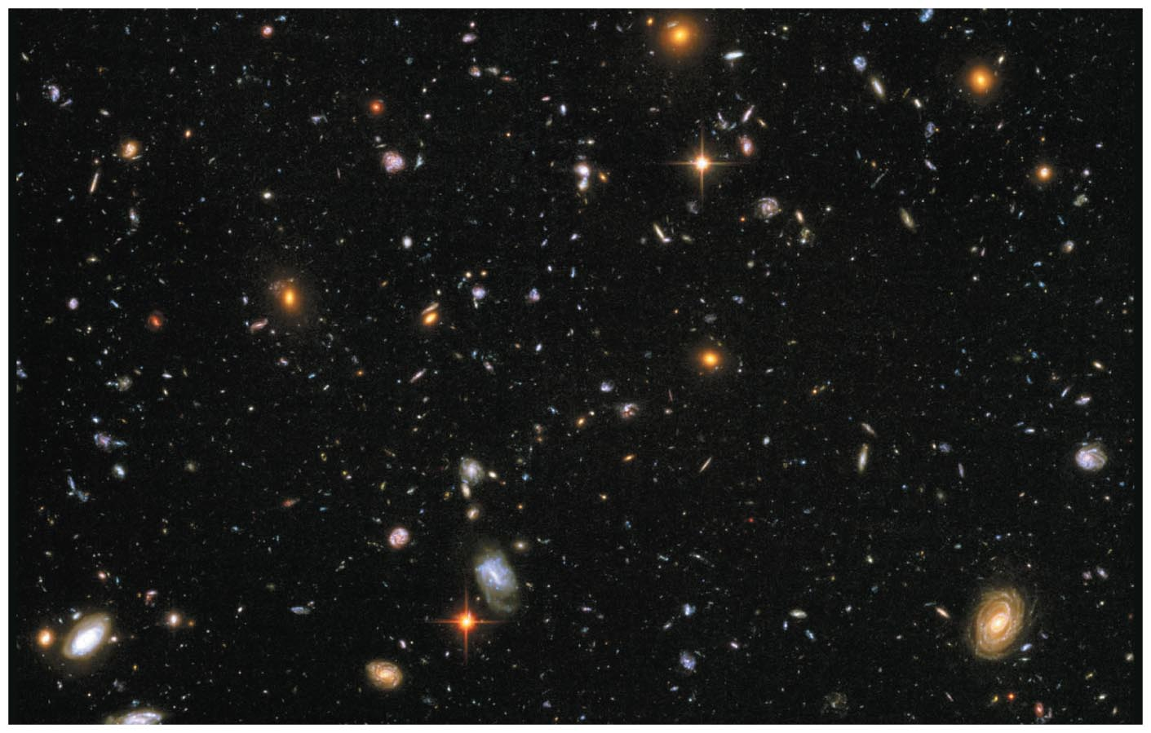
The Universe
The sum total of all matter and energy: everything within and between all galaxies

Slide 14
Notation: Orders of magnitude
10² = 100 = 1 with 2 zeros after it
10³ = 1000 = 1 with 3 zeros after it
10⁹ = 1 with 9 zeros after it = 1 billion
10¹¹ = 1 with 11 zeros after it = 100 billion

Slide 15

How big is the (observable) Universe?
The Milky Way is one of about 100 billion galaxies
10¹¹ stars/galaxy x 10¹¹ galaxies = 10²² stars in the universe
As many stars as grains of (dry) sand on all Earth’s beaches…
Notes:
The textbook suggests also pointing out that we are talking about the OBSERVABLE universe, since we do not know the extent of the ENTIRE universe.

Slide 16
Suppose you tried to count the more than 100 billion stars in our galaxy, at a rate of one per second…
How long would it take you?
Thought Question
a few weeks
a few months
a few years
a few thousand years

Slide 17
How did I know this?
A year has about 3 x 10⁷ seconds
100 billion stars = 10¹¹ stars
or “a few thousand years”

Slide 18
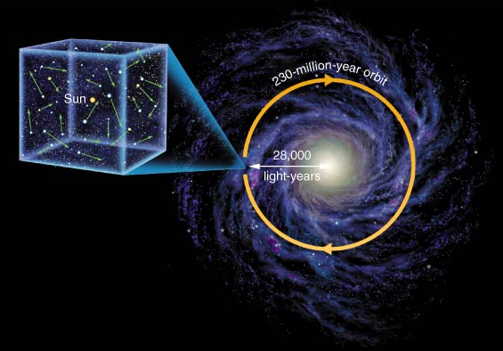
Our Sun moves randomly relative to the other stars in the local Solar neighborhood…
… and orbits the galaxy every 230 million years.
Typical relative speeds of > 70,000 km/hr (!)
But stars are so far away that we can’t easily notice their motion

Slide 19
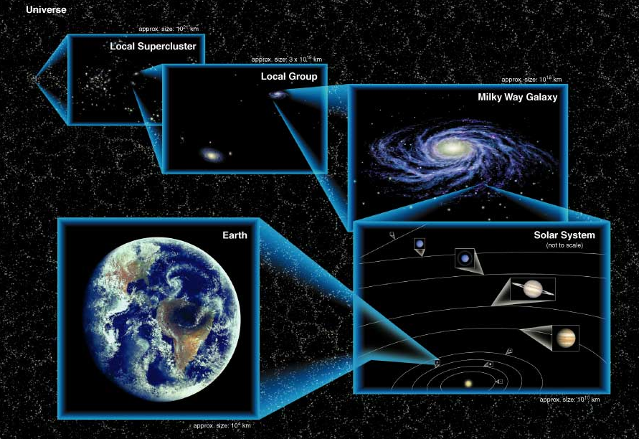
Our place in the universe

Slide 20
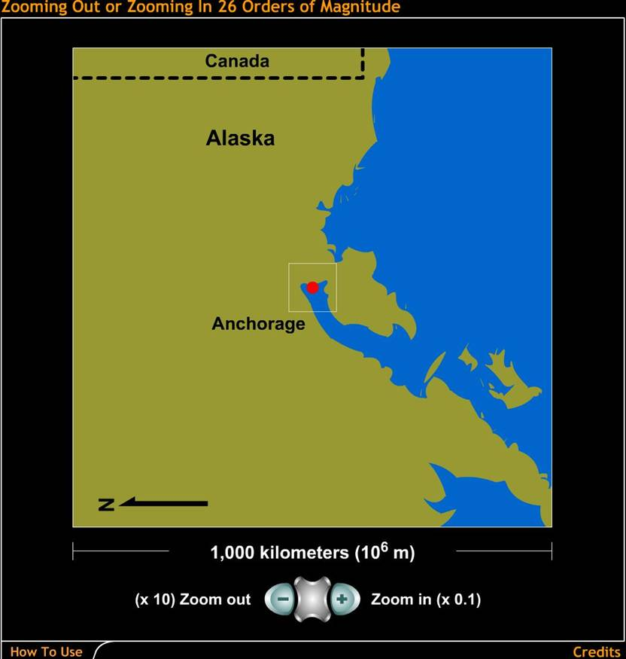

How big is the universe?
Let's step through the universe in powers of 10:
Notes:
Here's another way to review the scales of the universe, using the famous power of 10 motif. Again, this applet comes from the "Scale of the Universe" tutorial on the book web site. Also a good way to review power of 10 notation…

Slide 21
Geometry of the Earth relative to the Solar System
The Sun and all the planets except Pluto lie in a “plane” called the “Ecliptic plane”
Credit: O’Connell, U Va.

Slide 22
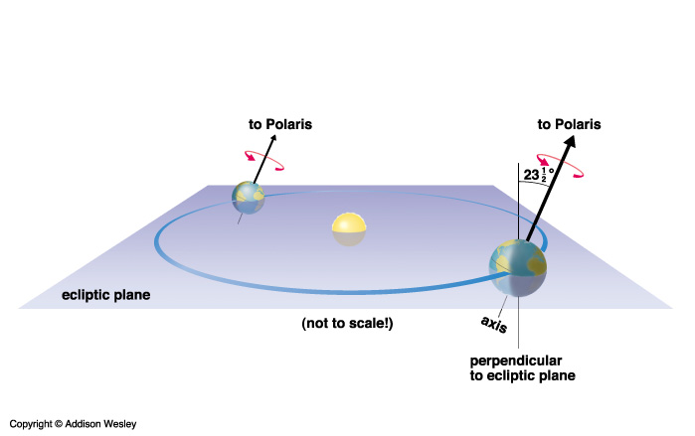
But Earth’s rotation axis is not perpendicular to this plane
Earth’s rotation axis is inclined at 23.5 degrees
North rotational pole points to the North Star, Polaris
Note that both rotation and motion around Sun are counter-clockwise, if you are looking from above the N pole

Slide 23
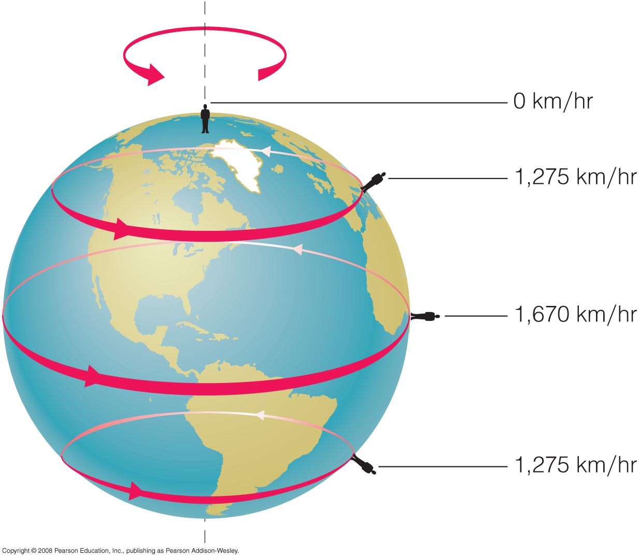
How is Earth moving in our solar system?
Contrary to our perception, we are not “sitting still.”
We are moving with the Earth in several ways, and at surprisingly fast speeds…
The Earth rotates around its axis once every day.
Notes:
Mention Joshua and Sun Stand Thou Still

Slide 24
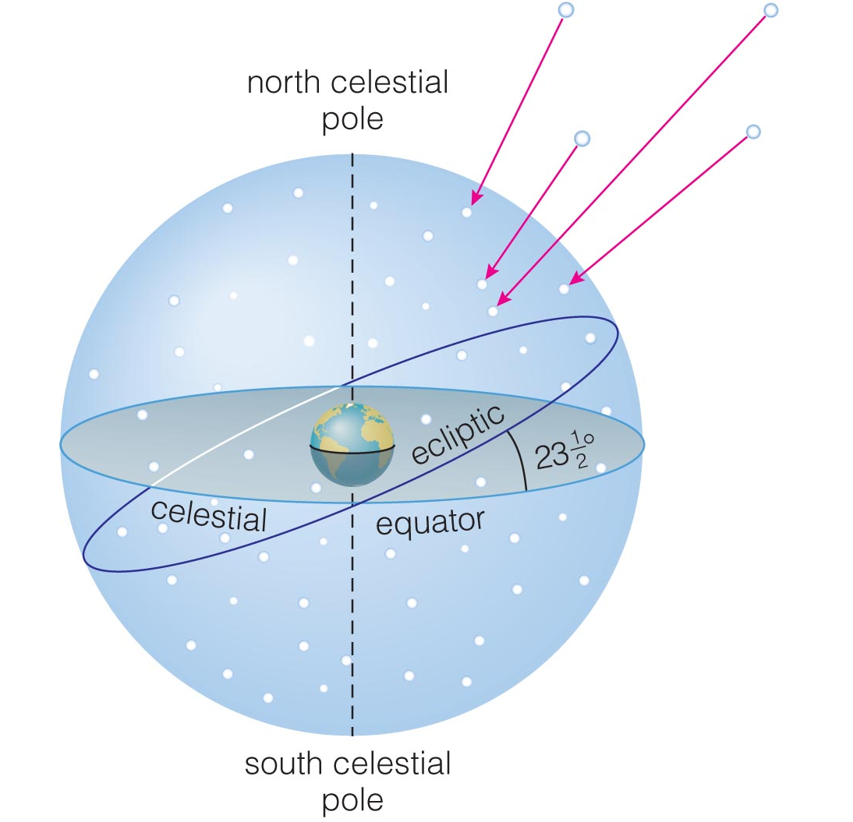
The “Celestial Sphere”
Stars at different distances all appear to lie on the “celestial sphere.”
Ecliptic is Sun’s apparent path through the celestial sphere.
Because our Solar System lies almost in a plane, planets follow paths along ecliptic as well.

Slide 25
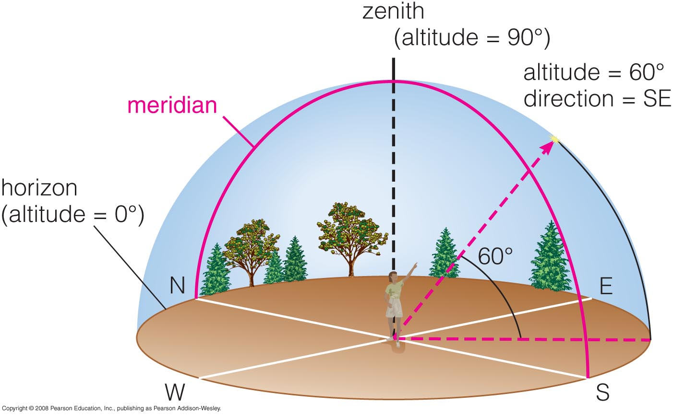
The Local Sky
Zenith: The point directly overhead
Horizon: All points 90° away from zenith
Meridian: Line passing through zenith and connecting N and S points on horizon

Slide 26
Results of the tilt of Earth’s axis
Seasons
Apparent motions of stars in sky
  and how these vary with where you are on the Earth
Apparent paths of planets and Sun along the ecliptic
Precession of the Earth’s axis
  in 15,000 AD, the “North Star” won’t be Polaris any more, it will be Vega (the brightest star in the Summer Triangle)

Slide 27
Seasons: Key concepts
Earth's rotation axis is tilted with respect to its orbital plane
Tilt angle changes the angle of sunlight striking the Earth's surface
At a fixed location on the Earth, the angle of the sunlight varies with time
Seasons!
Other planets have different tilts, and thus different types of seasons

Slide 28
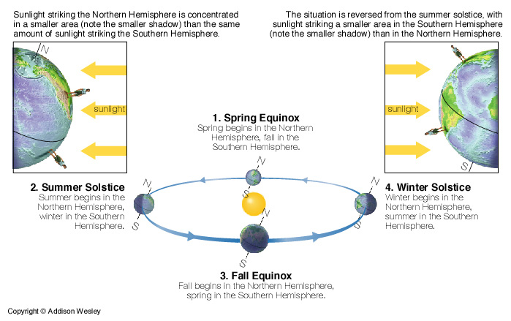
Seasons: summer is when your hemisphere is tipped toward Sun

Slide 29
Seasons: summer is when your hemisphere is tipped toward Sun
Note: Earth is closest to Sun in January, farthest in July!

Slide 30
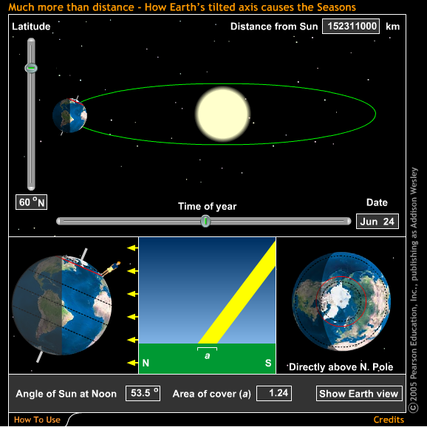
What causes the seasons, cont’d
Tilt of Earth’s axis causes sunlight to be spread out differently in summer and winter
Click here
Notes:
Click on the yellow arrow to bring up the web-page demo. It will take a while, and you’ll have to click at least two pop-up boxes warning about potential viruses. When you are done with the web-page demo, go to the dock and click once on the Powerpoint icon. That should bring you back to this ppt presentation.

Slide 31
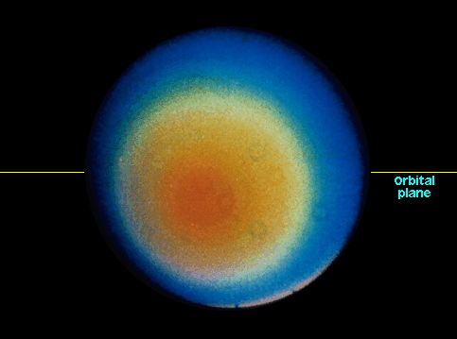
Most extreme seasons in Solar System: Uranus has a 42-year summer!
Uranus is tipped on its side:
  Rotation axis lies almost in its orbital plane
Uranus takes 84 Earth-years to go around the Sun
So the North polar regions of Uranus have summer (in this case, continuous sunlight) for 42 Earth-years!
orbital plane
Uranus
rotational pole

Slide 32
ConcepTest
I will pose a question on next slide.
First, each of you will have one minute to think about the answer (three multiple choices). This is not a trick question: think conceptually.
Then, break into groups of 2 or 3
You will have two minutes to convince your neighbors of the best answer. Discuss!
I will then ask for a show of hands for the three multiple choices, and we will discuss the results.

Slide 33
ConcepTest
You are having an argument with a friend about what causes Earth’s seasons. Your friend insists the difference between summer and winter is that the Earth is closer to the Sun in summer. Which of the following is the best fact you can use to convince your friend that his/her explanation must be wrong? Why?
a) days are shorter in winter than in summer
b) if you are above the Arctic Circle in winter, there is a long period of time when the sun never rises
c) when it is winter in the Northern Hemisphere, it is summer in the Southern Hemisphere

Slide 34
ConcepTest
You are having an argument with a friend about what causes Earth’s seasons. Your friend insists the difference between summer and winter is that the Earth is closer to the Sun in summer. Which of the following is the best fact you can use to convince your friend that his/her explanation must be wrong? Why?
a) days are shorter in winter than in summer
b) if you are above the Arctic Circle in winter, there is a long period of time when the sun never rises
c) when it is winter in the Northern Hemisphere, it is summer in the Southern Hemisphere

Slide 35
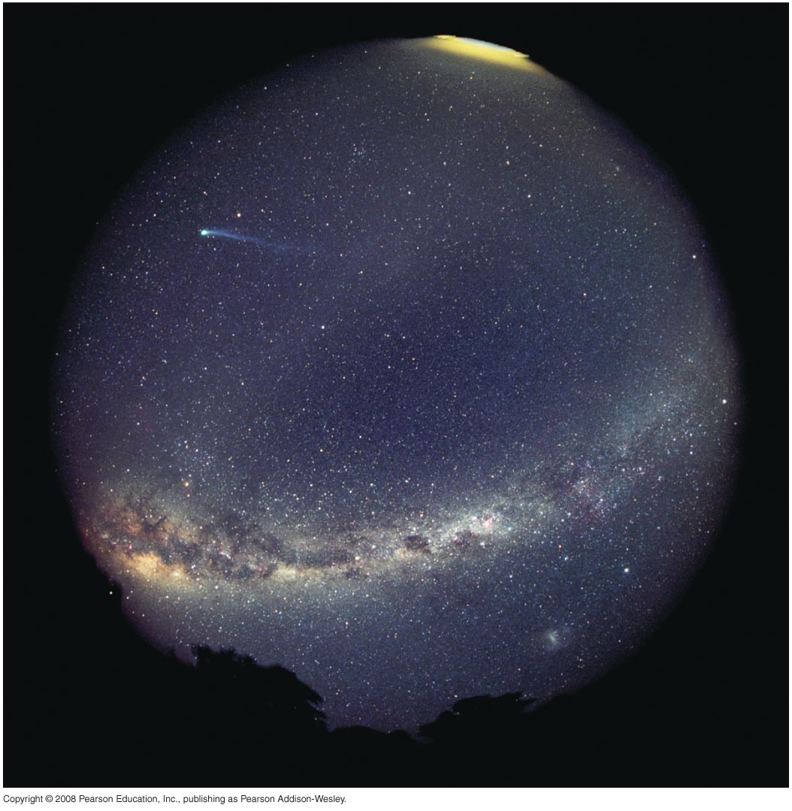
What does the universe look like from Earth?
With the naked eye, we can see more than 2,000 stars as well as the Milky Way (the plane of our Galaxy).
All the stars we see with our naked eyes are in our own Galaxy

Slide 36
With a telescope, we can see distant galaxies in long time exposures
Hubble Space Telescope

Slide 37
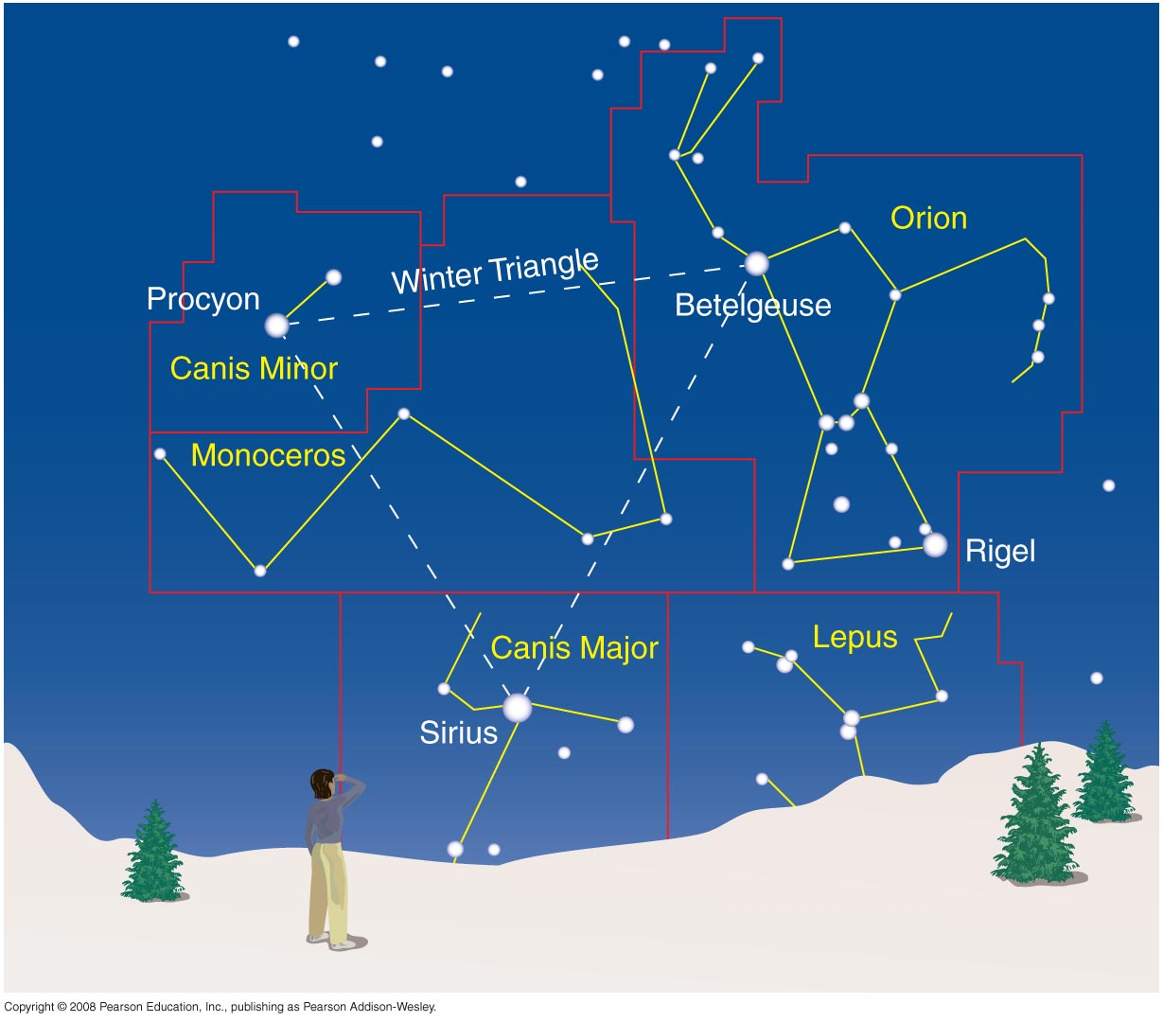
Constellations
A constellation is a region of the sky.
In our Western Civilization, 88 constellations fill the entire sky.
Different cultures have invented different constellations for themselves.

Slide 38
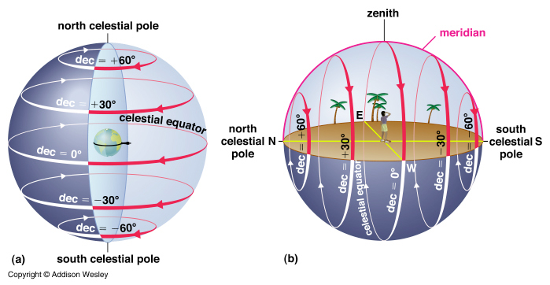
Nightly motion of stars is straight up and down if you are at the equator
Notes:
What constellations can you think of?

Slide 39
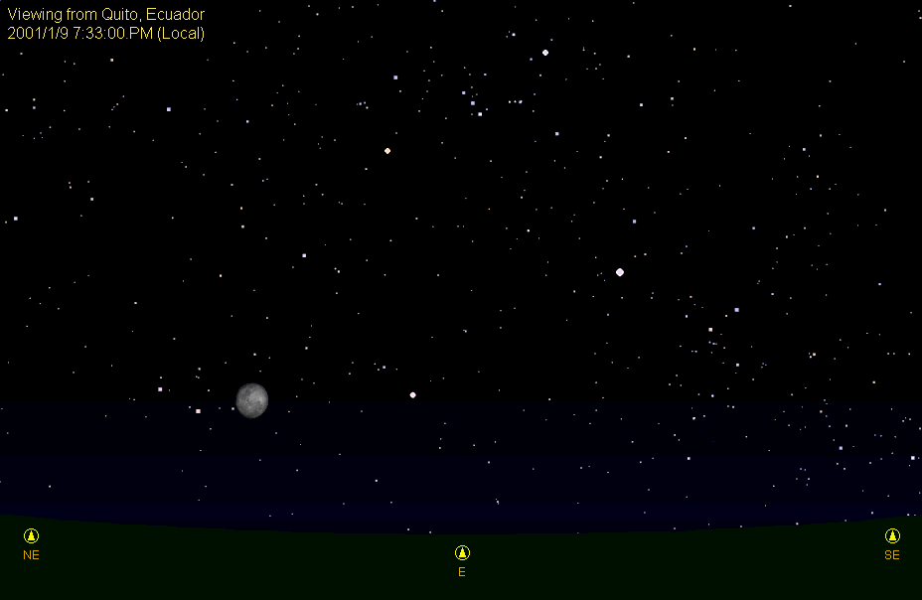
Nightly motion of stars is straight up and down if you are at the equator
© Richard Pogge, Ohio State University.

Slide 40
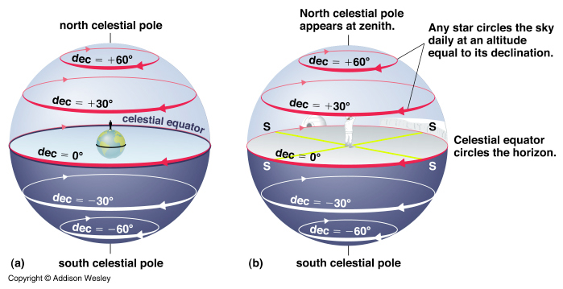
Nightly motion of stars is horizontal if you are at the North Pole

Slide 41
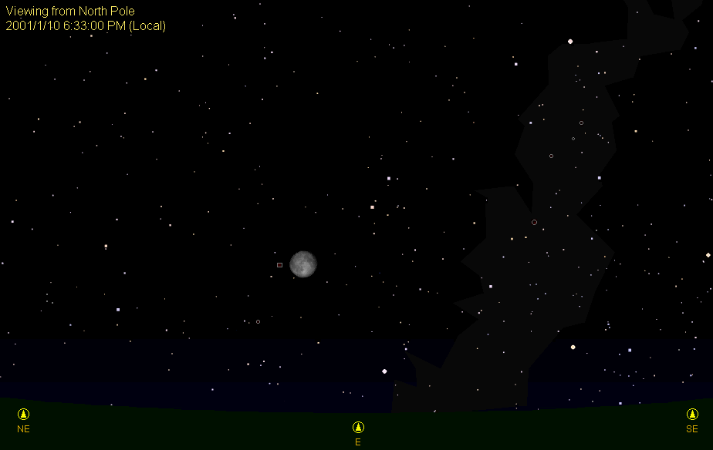
Nightly motion of stars is horizontal if you are at the North Pole
© Richard Pogge, Ohio State University.

Slide 42
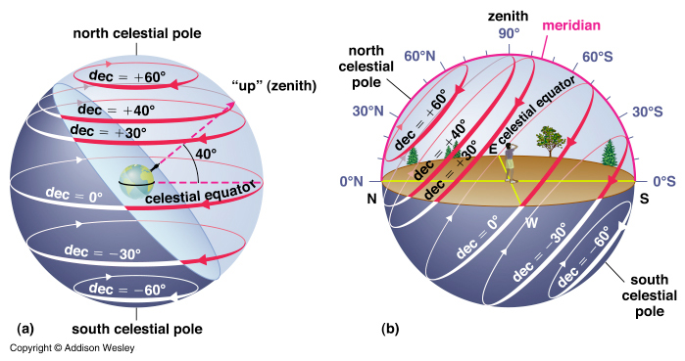
Nightly motion of stars if you are at latitude 40 deg North
Note: Latitude of Santa Cruz is 36.974 North

Slide 43
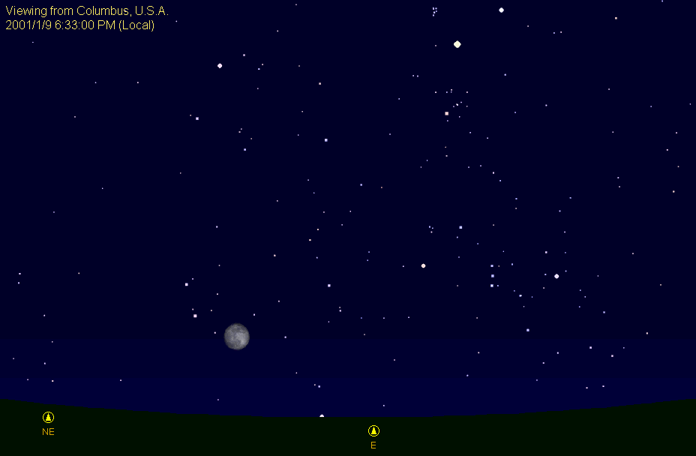
Nightly motion of stars at lat 40 deg North, looking to East
© Richard Pogge, Ohio State University.

Slide 44
Nightly motion of stars at latitude 40 deg North, looking to North

Slide 45
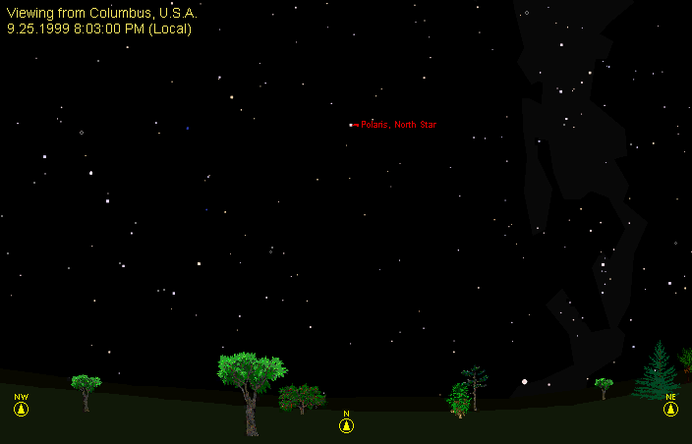
Nightly motion of stars at latitude 40 deg North, looking to North
© Richard Pogge, Ohio State University.

Slide 46
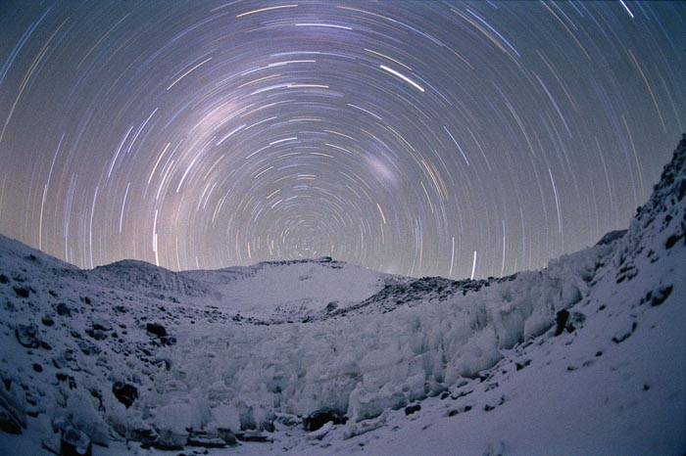
Where are we?

Slide 47
The Cosmic Distance Scale
What is a light-year?
First discuss speed of light.
Light doesn’t travel infinitely fast.
If light propagates in a vacuum (as in outer space), its speed is a very specific number:
  c = 300,000 km/sec = 3 x 10¹⁰ cm/sec
At this speed, light would circle the Earth eight times in 1 second

Slide 48
Since speed of light is constant, can use it to measure distance
distance = speed x time
Use “dimensional analysis”:
  Write down units of each quantity in an equation
  Then cross out places where the same unit is in a numerator and denominator
Example:

Slide 49
Since speed of light is constant, can use it to measure distance
distance = speed x time
Use “dimensional analysis”:
  Write down units of each quantity in an equation
  Then cross out places where the same unit is in a numerator and denominator
Example:

Slide 50
Define a light-year
A light-year is the distance that light travels in one Earth-year
How big is it?

Slide 51
Some examples of light travel-time
The Moon:
  It takes light 1 sec to travel from the moon to the Earth, so the Moon 1 light-sec away
The Sun:
  It takes light 8 minutes to travel from the Sun to the Earth, so the Sun is 8 light-minutes away
The nearest star, Proxima Centauri:
  It takes light about 4 years to travel from Proxima Centauri to the Earth, so this star is 4 light-years away

Slide 52
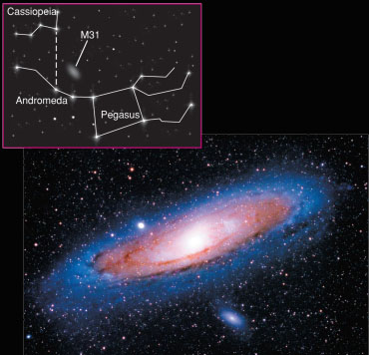
Example:
This photo shows the Andromeda Galaxy as it looked about 2 1/2 million years ago.
Question: When will we be able to see what it looks like now?
Notes:
Answer to question: in about 2.5 million years. But point out that for a galaxy, not much will change in that time.
Also worth noting: This photo shows 100,000 years of time, because the galaxy is about 100,000 light-years in diameter. Thus, we see the near side as it was 100,000 years later than the time at which we see the far side.

Slide 53
Implications of the finite speed of light
Because it takes light a finite amount of time to reach us,
  the farther away we look in distance, the further back we look in time
In 1987 when we saw a supernova explosion in the Large Magellanic Cloud (a neighboring galaxy150,000 light-years away), the supernova had actually exploded 150,000 years ago
When we look at galaxies that are more and more distant from us, we are seeing them at younger and younger stages of their evolution

Slide 54
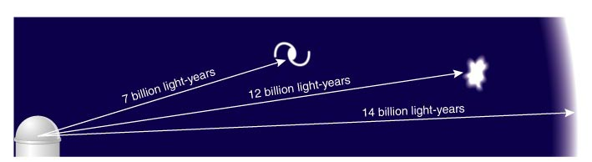
At great distances, we see objects as they were when the universe was much younger

Slide 55
ConcepTest
If the speed of light were half what it is now, then a “light-year” would
a) take half as long to traverse at light speed
b) take the same amount of time to traverse at light speed
c) last twice as many months
d) last half as many months

Slide 56
ConcepTest
If the speed of light were half what it is now, then a “light-year” would
a) take half as long to traverse at light speed
b) take the same amount of time to traverse at light speed
c) last twice as many months
d) last half as many months

Slide 57
The expansion of the universe and the Big Bang
Observation:
  Virtually every galaxy outside our Local Group is moving away from us
  The farther away a galaxy is, the faster it is moving away from us
  How is the observation made? From Doppler shift of spectral lines (will discuss in later lecture).
    Color of light becomes redder if the object emitting the light is moving away from us.
Recession velocities are large:
  tens of thousands to 100’s of thousands of km/sec

Slide 58
What’s going on?
Entire universe is expanding
  (It’s not that everybody hates us....)
Furthermore, at every place in the universe, it looks like the rest of the galaxies are all receding, and more distant galaxies are receding faster
Analogies to help understand this:
  A jungle gym that whose bars are all getting longer
  A sponge cake that is expanding as it bakes

Slide 59
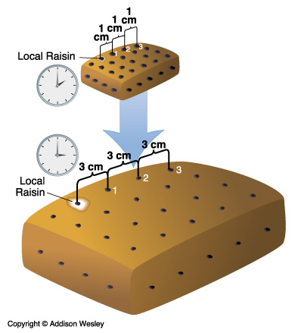
“Local Sponge Cake” Example
Every raisin sees all the other raisins moving away from it
More distant raisins move away faster
Click here
Notes:
Click on the arrow to bring up the web-page demo. It will take a while, and you’ll have to click at least two pop-up boxes warning about potential viruses. When you are done with the web-page demo, go to the dock and click once on the Powerpoint icon. That should bring you back to this ppt presentation.

Slide 60
The Big Bang
This is as far back as we can hope to measure
Every place in the universe was (almost) infinitely dense and infinitely hot
Ever since the Big Bang, the universe has been expanding, becoming less dense (on the average), and cooling off

Slide 61
ConcepTest
There must be some very large distance such that light from a galaxy at that distance hasn’t yet reached us during the age of the universe. The expansion velocity of galaxies at that distance, relative to us, must be
a) zero
b) infinite
c) less than the speed of light
d) the speed of light or greater

Slide 62
ConcepTest
There must be some very large distance such that light from a galaxy at that distance hasn’t yet reached us during the age of the universe. The expansion velocity of galaxies at that distance, relative to us, must be
a) zero
b) infinite
c) less than the speed of light
d) the speed of light or greater

Slide 63
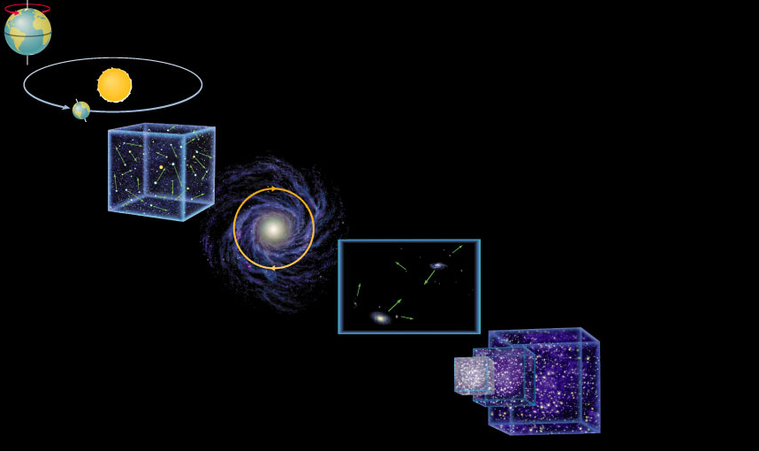
The Universe in motion...
Earth rotates on axis: > 1,000 km/hr
Earth orbits Sun: > 100,000 km/hr
Solar system moves among stars: ~ 70,000 km/hr
Milky Way rotates: ~ 800,000 km/hr
Milky Way moves
in Local Group
Universe
expands

Slide 64
Review
How can we know that the universe was like in the past?
  When we look to great distances we are seeing events that happened long ago because light travels at a finite speed
Can we see the entire universe?
  No, the observable portion of the universe is about 14 billion light-years in radius because the universe is about 14 billion years old

Slide 65
Our Celestial Address
Physical Sciences Building
UCSC
City of Santa Cruz
California
USA
The Earth
The Solar System
The Milky Way Galaxy
The Local Group of Galaxies
The Local Supercluster of Galaxies
The Universe

Slide 66
Dark matter and dark energy: Unseen influences on the universe
Dark Matter: An undetected form of mass that emits little or no light, but whose existence we infer from its gravitational influence
Dark Energy: An unknown form of energy that seems to be the source of a repulsive force causing the expansion of the universe to accelerate

Slide 67
The surprising contents of the Universe
Ordinary matter ~ 4.4%
Dark matter ~ 23%
Dark energy ~ 73%
(assumes energy = mass x c²)
All the atoms and molecules we are familiar with
are <5% of the mass of the universe (!)

Slide 68
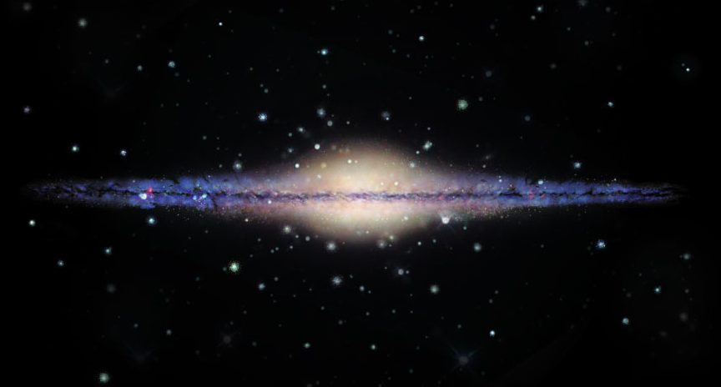
Detailed study of Milky Way’s rotation reveals presence of “Dark Matter”
Most of Milky Way’s light comes from its disk and bulge …
…. but most of the mass is in its dark halo. We don’t yet know what it’s made of.

Slide 69
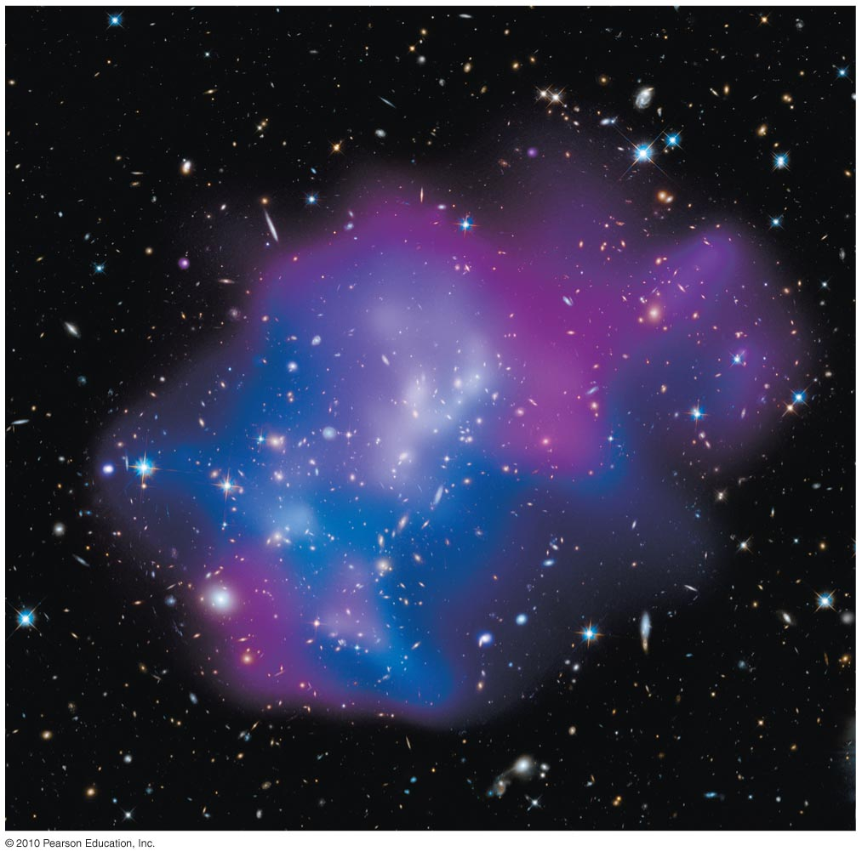
Measuring dark matter
in clusters of galaxies
Galaxy clusters contain large amounts of X ray-emitting hot gas.
Temperature of hot gas (particle motions) tells us cluster mass:
85% dark matter
13% hot gas
2% stars

Slide 70
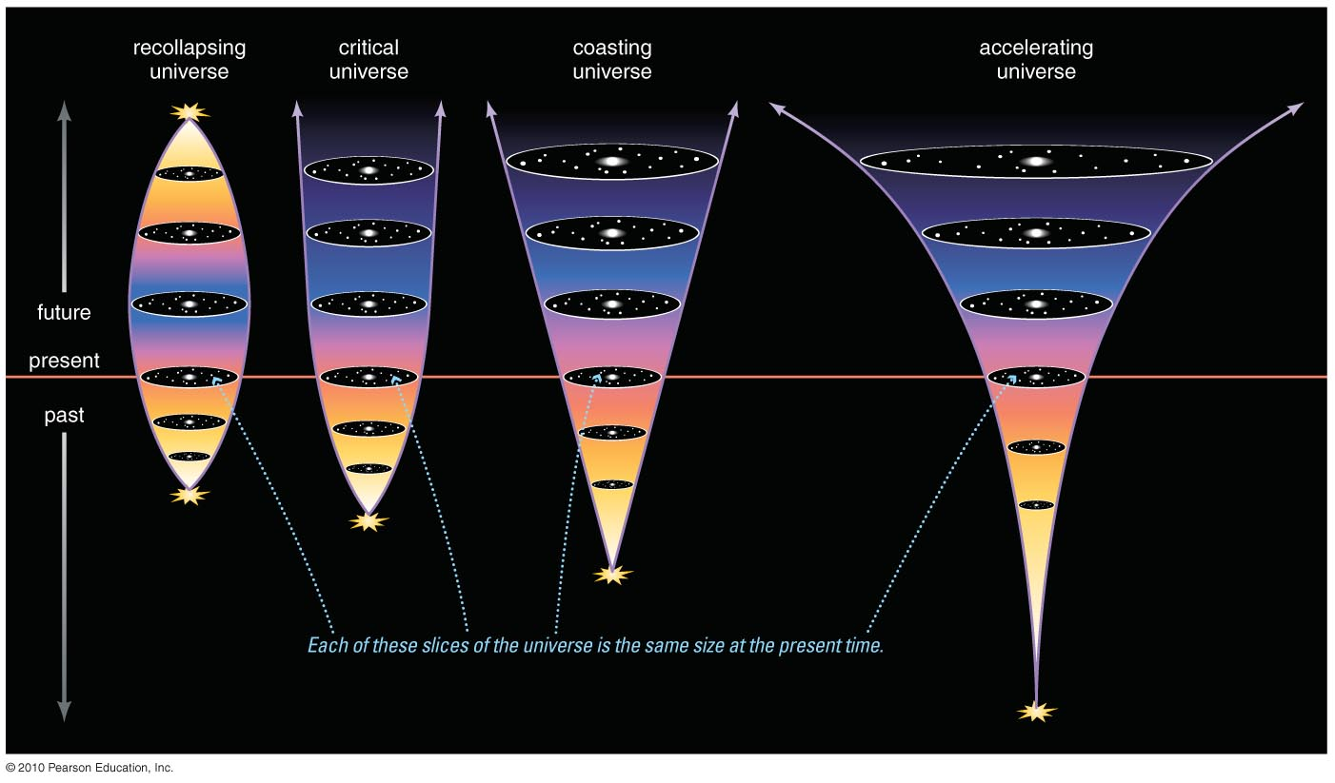
Will the universe continue expanding forever?

Slide 71
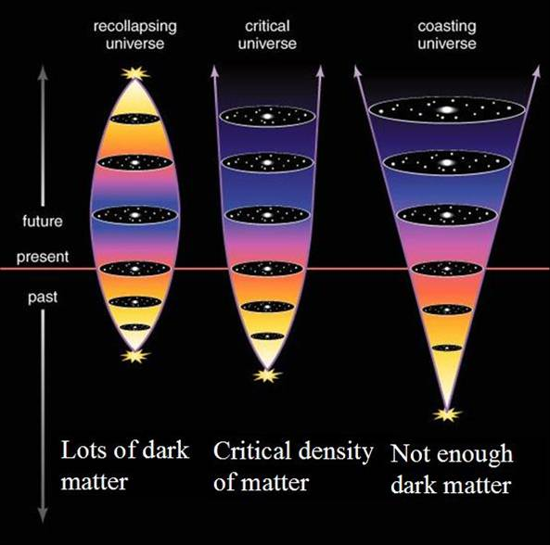
The fate of the universe depends on the amount of dark matter

Slide 72
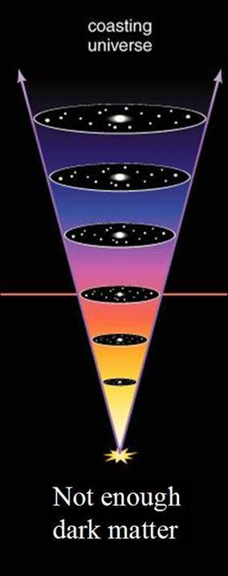
The amount of dark matter is ~25% of the critical density
Hence we expect the expansion of the universe to overcome its gravitational pull

Slide 73
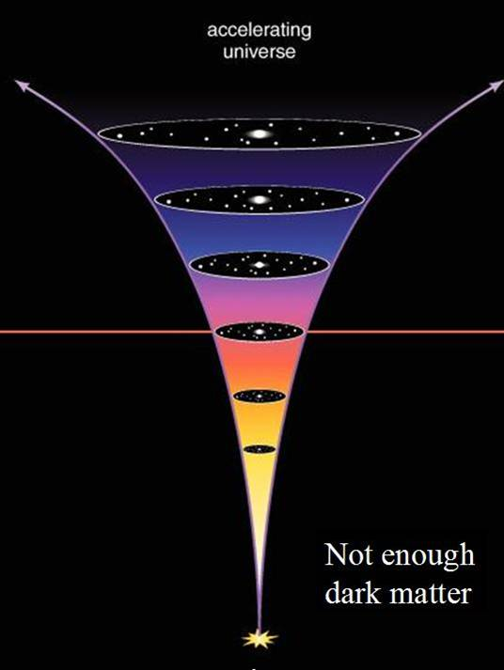
In fact, the expansion appears to be speeding up!
Dark Energy?

Slide 74
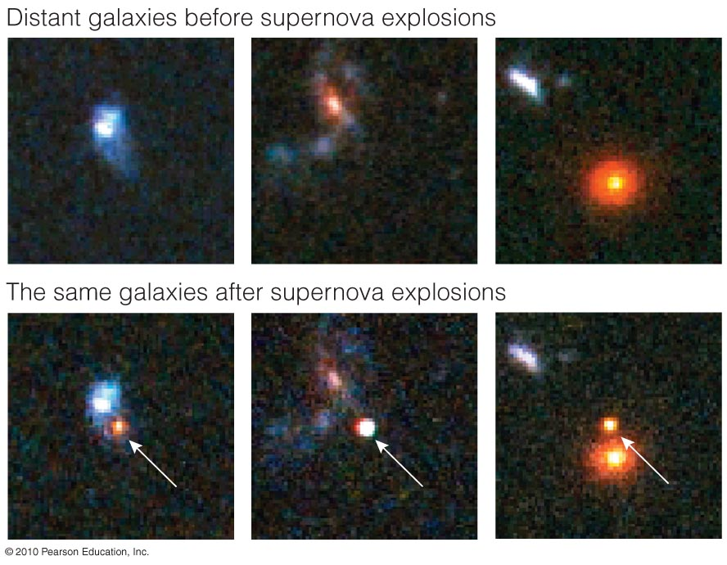
Insert TCP 6e Figure 20.14
Brightness of distant supernovae tells how much the universe has expanded since they exploded

Slide 75
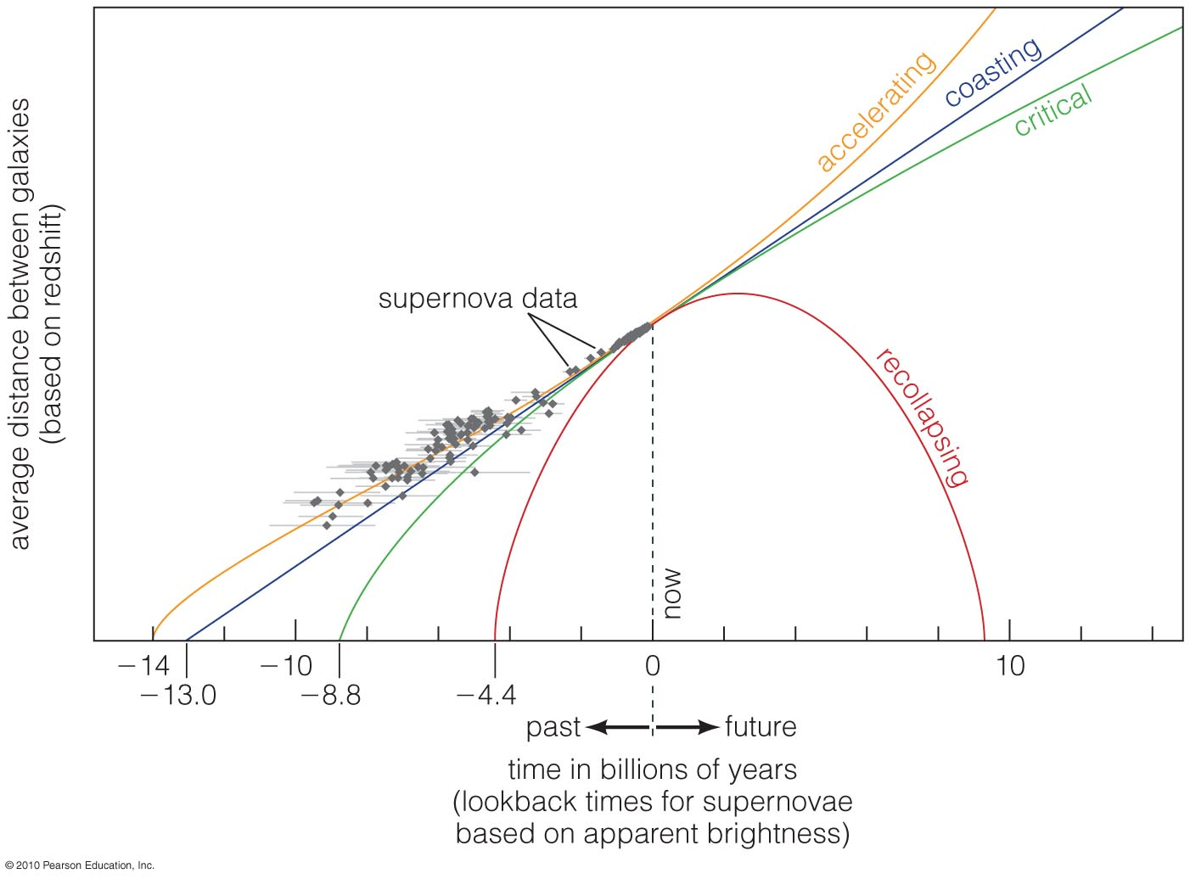
An accelerating universe best fits the supernova data
Supports the Dark Energy hypothesis

Slide 76
Review: Dark Matter and Dark Energy
Dark Matter:
  Exerts gravitational pull on all scales
  Many lines of evidence
  Has not yet been directly detected
Dark Energy:
  Main action is on largest physical scales
  Several lines of evidence, including accelerating expansion of universe
All the atoms and molecules we are familiar with
are <5% of the mass of the universe (!)

Slide 77
Reading assignments and next few lectures
Tuesday April 8th:
  Reading assignment: Chapters 3 and 4 in Bennett
  Lecture will cover Chapter 3 + 1st part of Chapter 4
Thursday April 10th: NO LECTURE
Tuesday April 15th
  Supplementary optional reading assignment with some calculus (I will post on the class website)
  Lecture will cover remainder of Chapter 4

Slide 78
Homework assignment
(problem set)
Due Tuesday April 15th
I will post the assignment on the class website, http://www.ucolick.org/~max/Astro18-2014/Astro18.html

